Slide 1
Final Project
Shuo-Yen Chueh

Slide 2
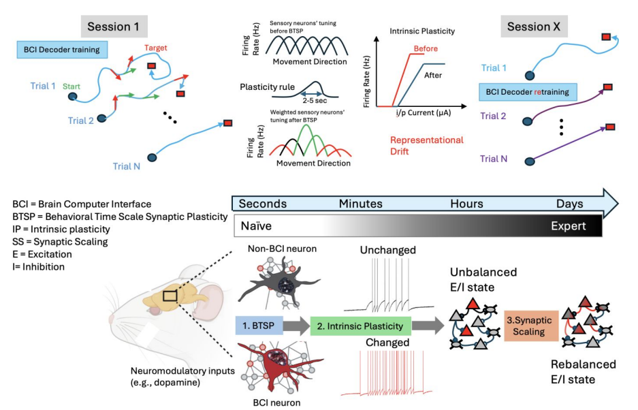
Introduction: Brain computer interface experiment
Metaplasticity model features: Intrinsic plasticity Behavior time scale plasticity Synaptic scaling
Through BCI task, the neuromodulatory influence and repeated activation result in the representation drift.
The representation drift will also affect the BCI performance
Chueh, S.-Y., et al. (2025). Metaplasticity and continual learning: Mechanisms subserving brain computer interface proficiency. bioRxiv.

Slide 3
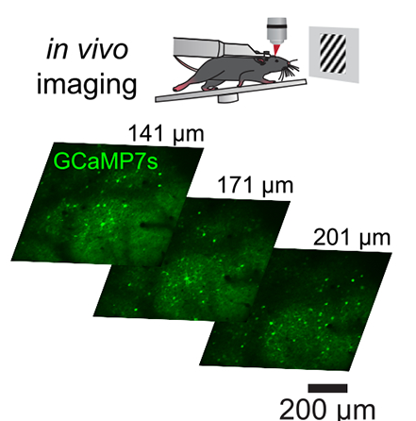
BCI task set up
The monitor will generate drift grating in different angel.
If the selected neurons have calcium activity, the signal will be fed in the 2P system and cause the drift grating speed up.
There are other selected neurons which have negative weight.
The goal is encouraging the mouse to learn to move the grating for certain threshold distance.
Bounds, H. A., et al. (2023). All-optical recreation of naturalistic neural activity with a multifunctional transgenic reporter mouse. Cell Reports

Slide 4
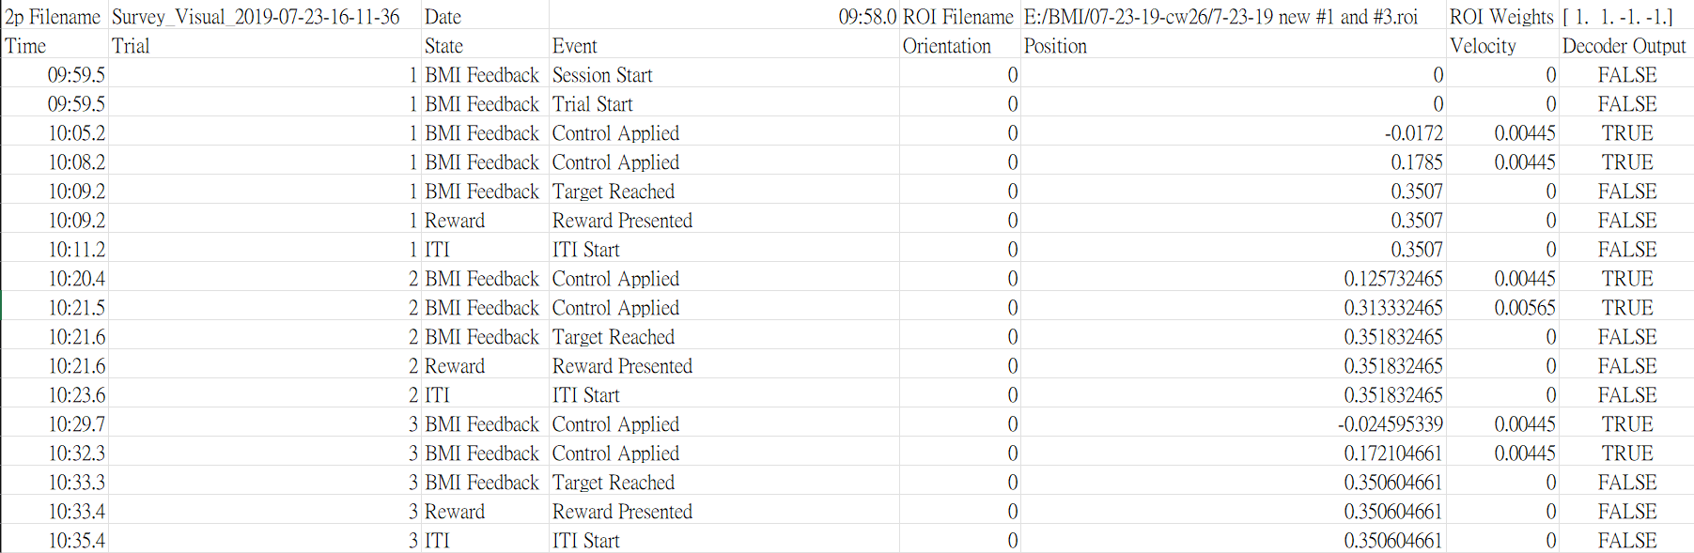
Behavioral data format
Behavioral experiment set up
Trial 1
Random start point
Trial 2

Slide 5
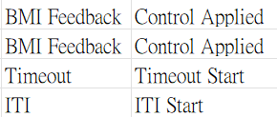
Behavioral data format
Behavioral experiment set up
Trial 1
Random start point
Trial 2
There are also other parameters to tune the behavioral set up, e.g. Impulse, max_velocity, stop & start threshold, random_start_range, ITI length…etc
Failed trial if time out

Slide 6
The purpose of original MATLAB code
Extract the basic information: 1. Total experiment duration 2. Total trials and successful trial count 3. Success rate and reward frequency 4. Average and standard deviation of trial duration
Visualization of trajectory: 1D & 2D version, Trial path length.
Batch file analysis: Output a summarization file.
Ensemble-based group analysis: plot the bar chart of each neuron ensemble giving the statistics results.

Slide 7
Goal
Output the same figures and files regarding the same input CSV file.
List the necessary functions for processing the data frame and write them as def functions.
Have the notation of each def function to ensure modification in the future.

Slide 8
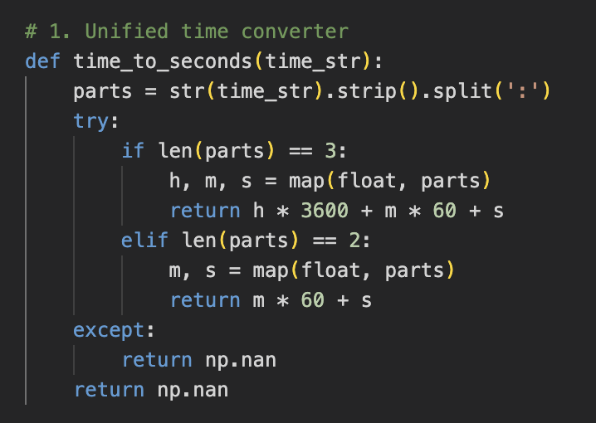
Function 1: time_to_seconds
Ensure input is the string.
Remove any extra space by .strip()
Split the time string into [‘HH’, ‘MM’, ‘SS’]
Covert them into second unit and compute the total duration.
Use this to calculate the average & standard deviation of trial duration.

Slide 9
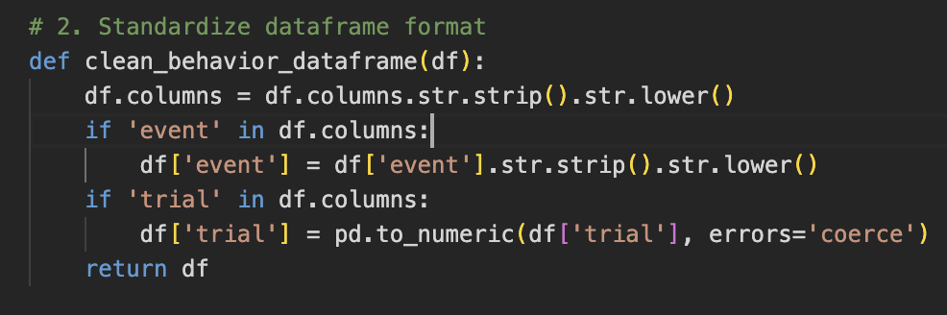
Function 2: clean_behavior_dataframe
Strips whitespace from both ends of each column name
Convert ‘event’ column names to lowercase. (e.g. Target Reached -> target reached)
Convert ‘Trial’ column to numeric.

Slide 10
Function 3: analyze_behavior_data
Clean the data by the previous functions. Measures total time span (in seconds) from the first to last timestamp in the file
Extracts all unique trial IDs (excluding any NaNs) and counts how many total trials occurred in the file
Filters for rows where the event was "target reached” and counts the number of distinct trials that had a successful outcome
Success Rate: % of trials that ended in success. Reward Frequency: how many successful trials occurred per minute
For each trial: Gets its start and end time and calculates how long the trial lasted (in seconds)

Slide 11
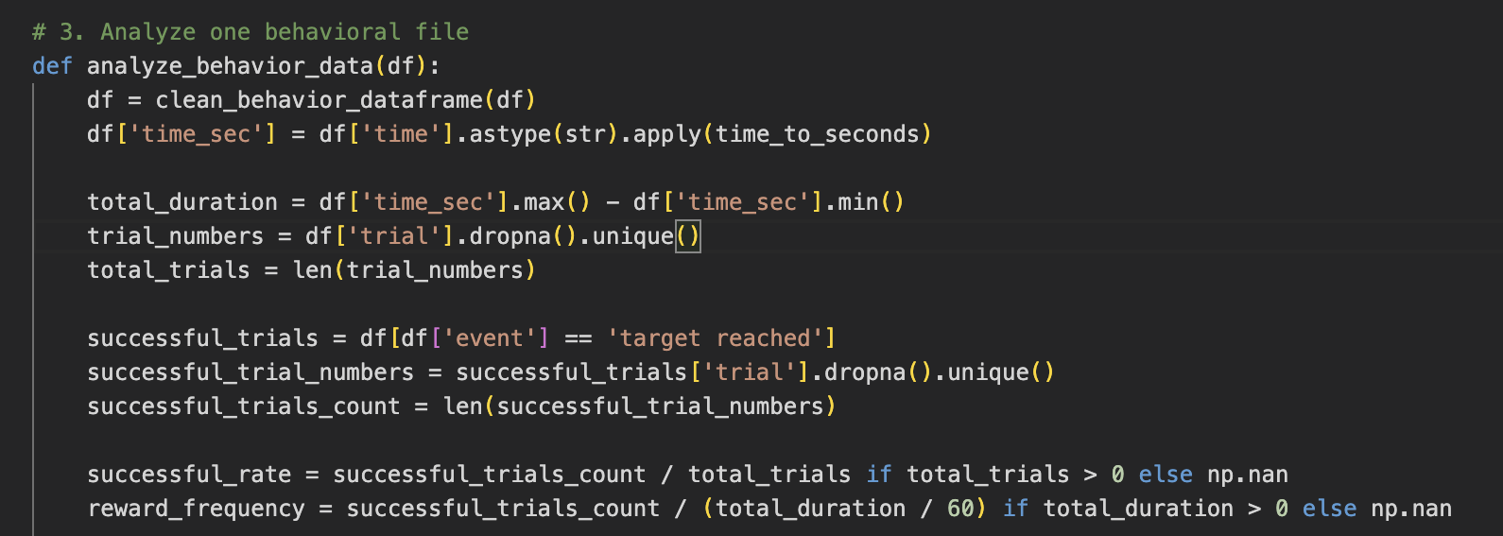
Function 3: analyze_behavior_data

Slide 12
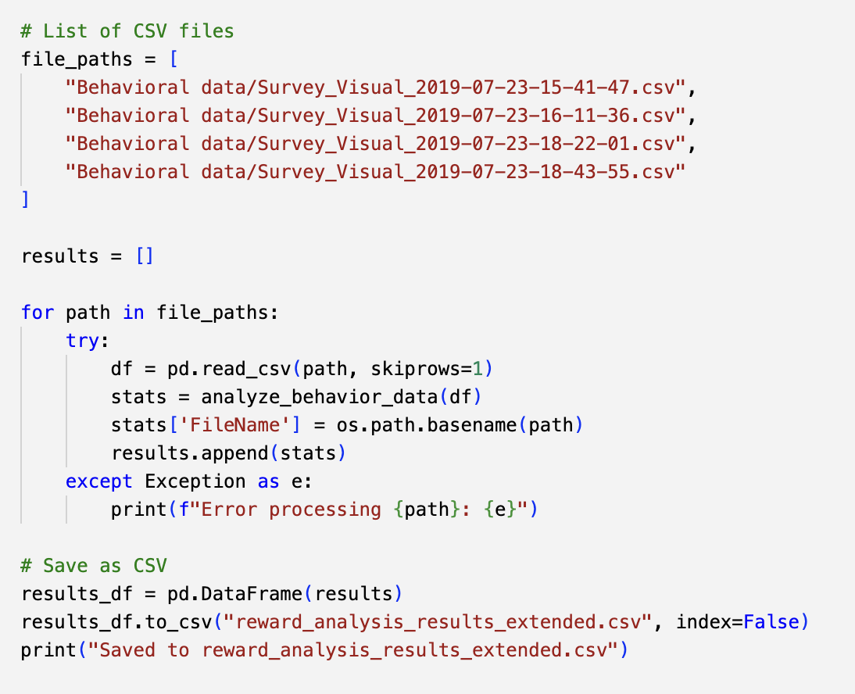

Slide 13
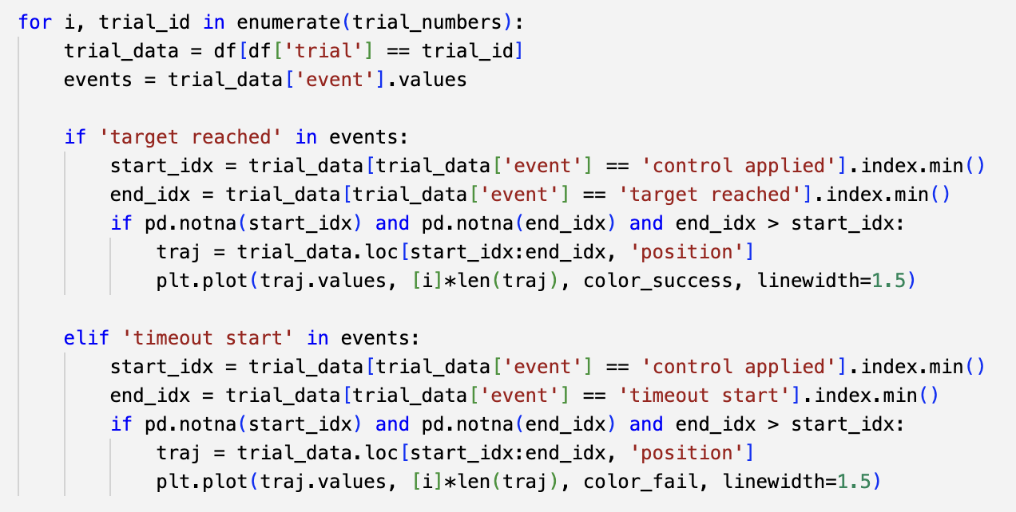
Function 4 & 5: Visualization
Visualize each trial as a 1D line of movement, using Position vs. Trial Number.
Get a list of unique trial IDs. Loop ( for and if loop) through each trial to plot its trajectory.

Slide 14
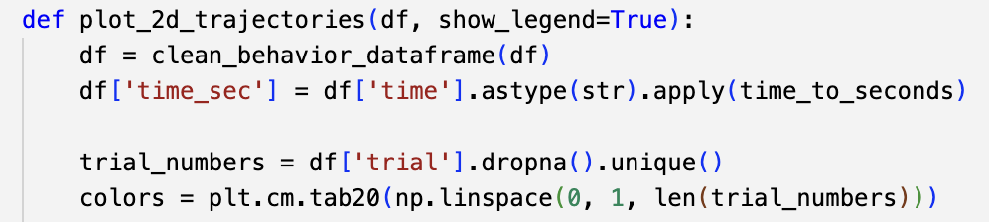
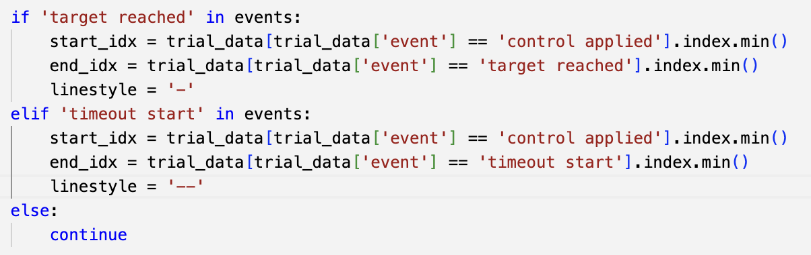
Function 4 & 5: Visualization
Assign a distinct color to each trial.
’target reached’ is the sign for successful trial. ‘timeout start’ for failed trial.

Slide 15
Behavioral data format
Behavioral experiment set up
Trial 1
Corresponding position
Trial 2

Slide 16
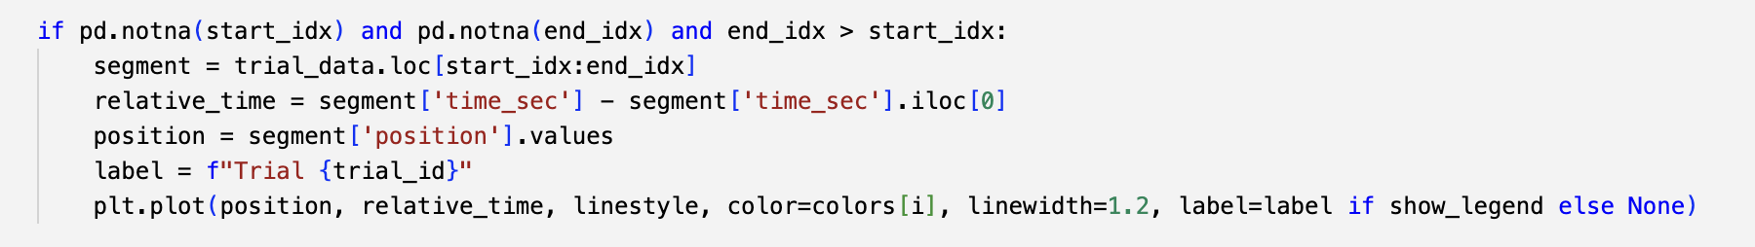
Function 4 & 5: Visualization
Extracts all rows between the start and end of a trial. This is the time window from "control applied" to "target reached" or "timeout start”
Converts absolute time → time relative to trial start. Sets the time at control applied to 0.0 seconds. This helps normalize across trials of different start times.
Extract position data and plot.

Slide 17
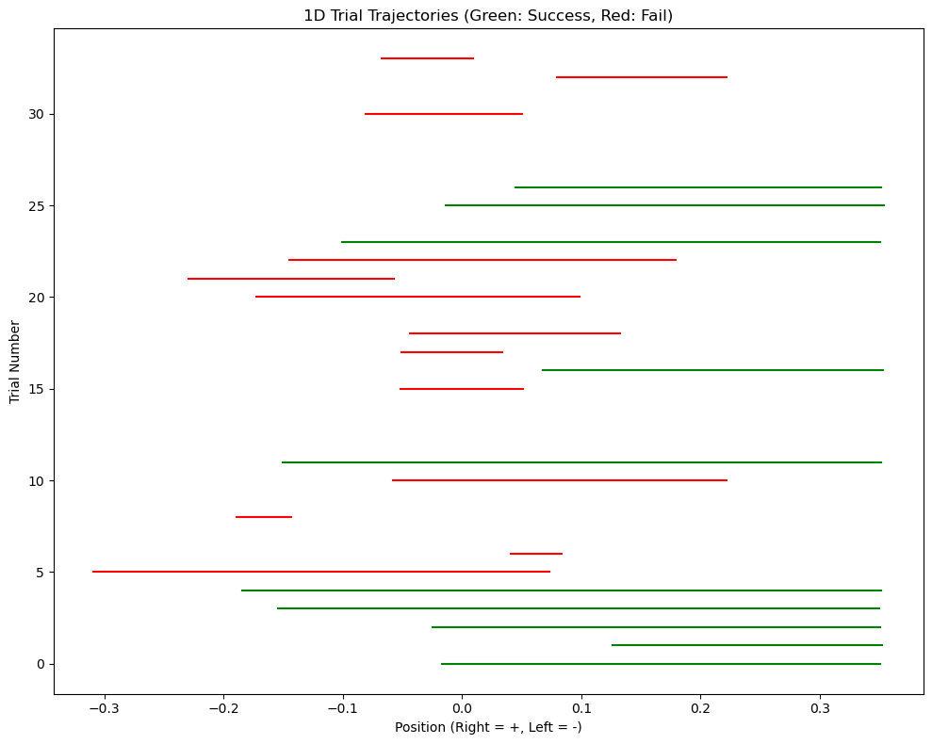
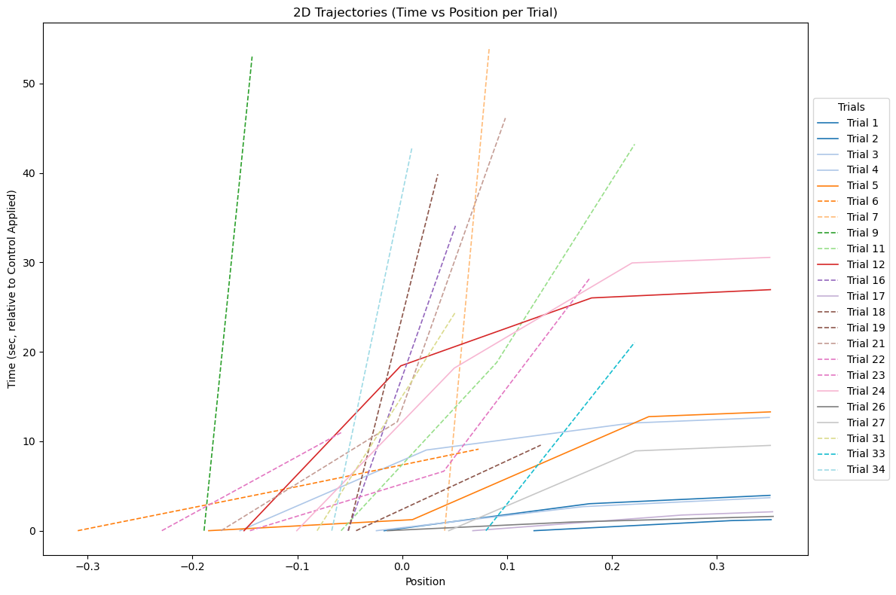
Trajectory plot: 1D & 2D versions

Slide 18
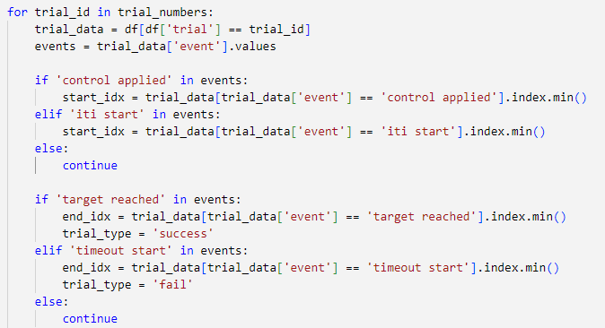
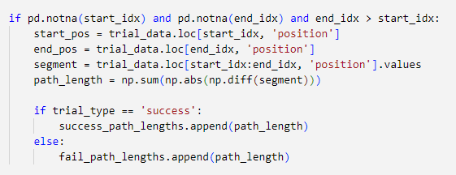
Function 6: calculate_path_lengths
Use “controlled applied” or “ITI start” events as the time point of start.
“target reached” is the end of successful trial. “timeout start” is the end of failed trial.
Loop each trial and selects the continuous sequence of position values from the trial start to the end.
computes the difference between each position point and the add them all up

Slide 19
Function 7: plot_ensemble_barplots
Add the “Ensemble” column manually.
DataFrame df must include these columns: 'Ensemble’, 'SuccessRate’, 'RewardFrequencyPerMin’, 'AverageTrialTime’
Assigns each ensemble group a unique color for plotting
For each group: Compute mean and standard error, store sample size for plotting

Slide 20
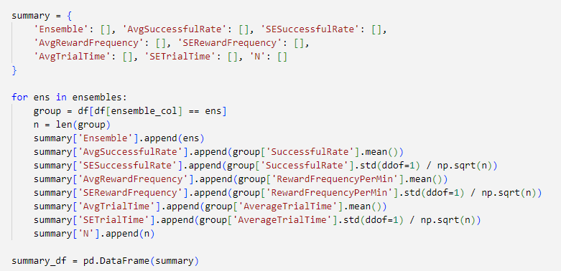
Initializes a dictionary that will be used to collect statistics per ensemble: Average values (mean), Standard error (SE), Sample size (n)
Loops through each unique Ensemble (experiment group).
Filters the dataframe to only rows matching that ensemble (group)
Stores how many rows there are (n) — used for SE and bar annotation.

Slide 21
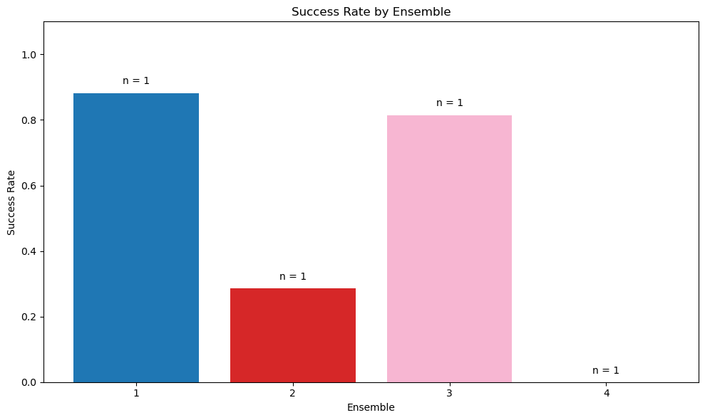
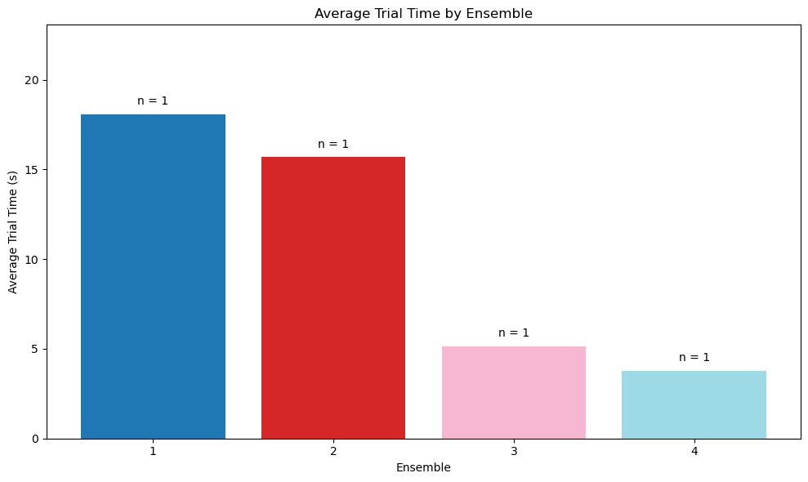
The bar chart of success rate & average trial time of each ensemble
*Because the sample size of each ensemble is only 1, there is not STD error in this figures.

